Slide 1
Back to the CompletableFuture
Dmitry Vinnik, @DmitryVinnik
Lead Software Engineer, Salesforce

Slide 2
What are our goals?
Goals
Concurrency and Its Forms
Misconceptions of Concurrency
Workflows: How’s and Why’s

Slide 3
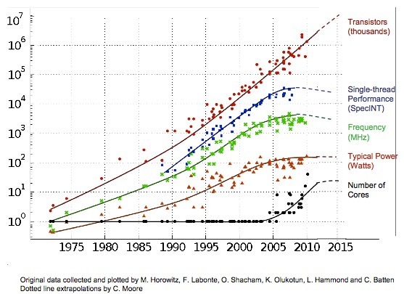
Why Concurrency?
Motivation
Multi-Core
Microservices
CCSs
Source: The Next Platform

Slide 4
Concurrency is a New Reality
Concurrency is a Reality
Conclusion?

Slide 5
But!
What’s in it for us?
No Idling
↑ UX
Benefits
Abstraction

Slide 6
Complexities
Thread Safety
Liveness
Only good parts, right?
Performance
SDLC

Slide 7
Beneficial
“Beautiful”
but
Complex

Slide 8

Concurrency
is like
Remind anything?
Source: Pixabay

Slide 9
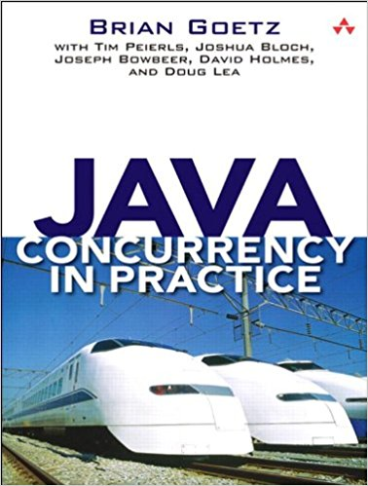

Concurrency & Sharks
Concurrency & Sharks

Slide 10
Fear
Fear
Admiration

Slide 11
Agenda
Single Threading
Single Threading
Multi Threading
Multi Threading
Fear
Admiration
Concurrency in Java
Concurrency in Java
Workflows
Workflows

Slide 12
Do I even care?
“It is too complicated”
“My app is single threaded”
“Not broken, don't touch it”

Slide 13
Design For Concurrency
Programming by Coincidence
Design by Contract
Temporal Coupling
Immutability &
Atomicity

Slide 14
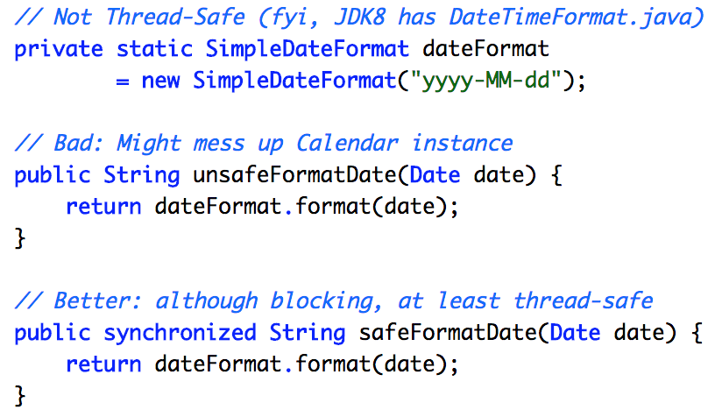
“Can't tell if it is broken, or if it never worked”
Programming by Coincidence
Programming by Coincidence

Slide 15
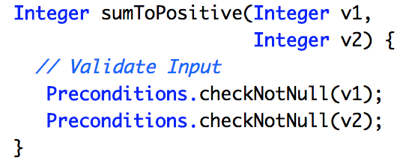
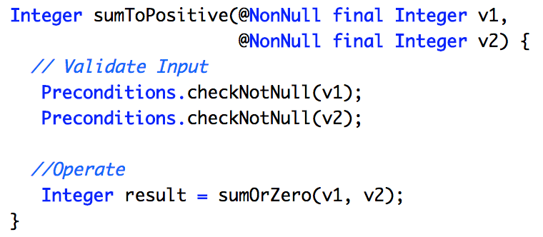
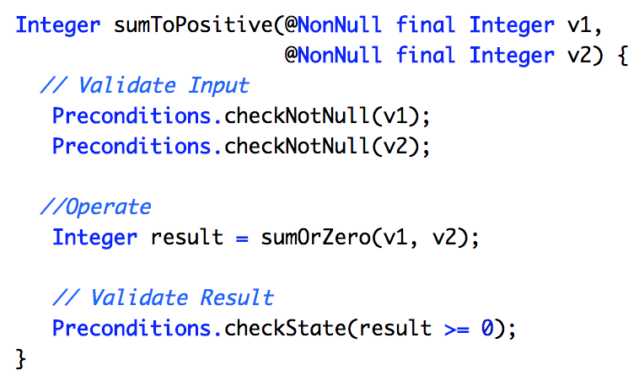
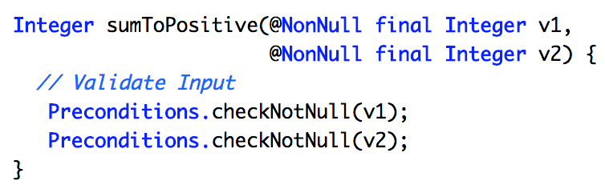
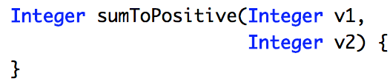
“Require No More,
Promise No Less”
Design by Contract
Design by Contract
Quote from Bertrand Meyer, “Design by Contract”

Slide 16
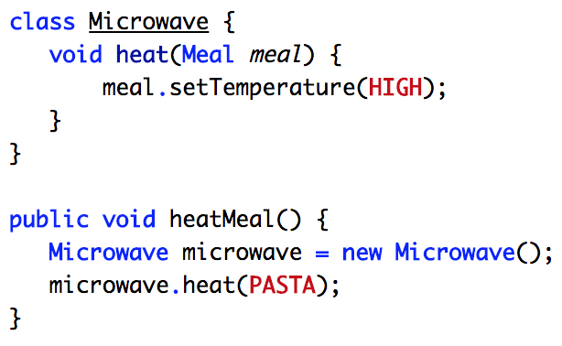
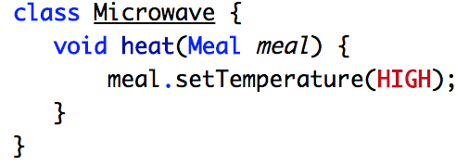
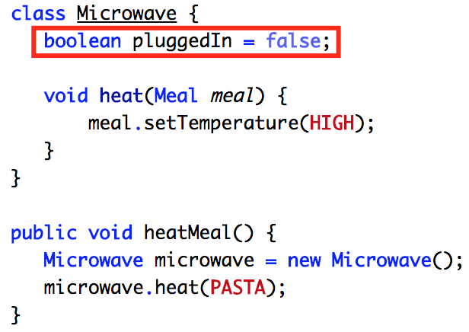
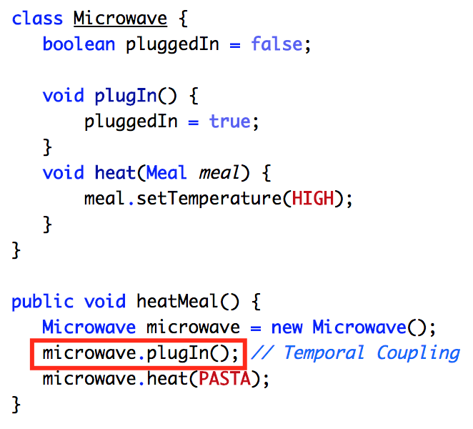
Temporal Coupling
Temporal Coupling
“Do time & order matter?”

Slide 17
Agenda
Single Threading
Single Threading
Single Threading
Single Threading
Multi Threading
Multi Threading
Multi Threading
Concurrency in Java
Concurrency in Java
Workflows
Workflows

Slide 18
Multithreading Forms
What forms can it take?
Multithreading
Concurrent Form
Concurrent Form
Parallel Form
Parallel Form
Asynchronous Form
Asynchronous Form

Slide 19
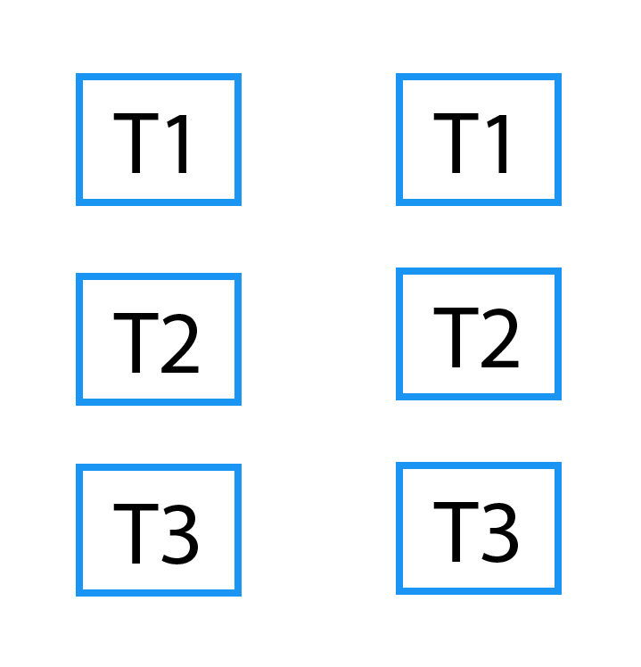
Form: Concurrency
Form: Concurrency
Multiple Tasks
Logically
Simultaneous
Multiple CPUs

Slide 20
Let’s Code Something
Too Abstract?

Slide 21


Form: Concurrency
Goal: Develop App
What do we need?

Slide 22
Form: Concurrency
T1
Coffee, Code, Coffee, Code, Coffee, Code...

Slide 23
Multithreading Forms
Concurrent Form
Concurrent Form
Concurrent Form
Parallel Form
Parallel Form
Parallel Form
Asynchronous Form
Asynchronous Form

Slide 24
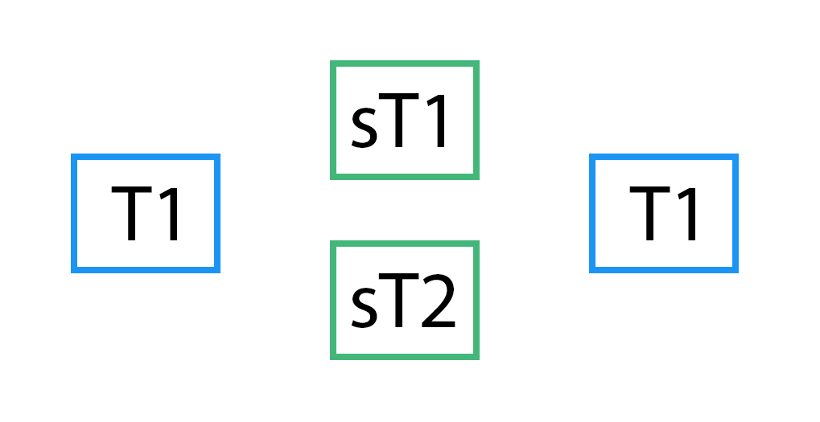
Form: Parallelism
Form: Parallelism
Multiple (Sub)Tasks
Physically
Simultaneous
Multiple CPUs

Slide 25
Form: Parallelism
Goal: Develop App
As Ambidexter
But Now

Slide 26
Form: Parallelism
T1
Coffee, Coffee, Coffee, Coffee, Coffee...
T2
Code, Code, Code, Code, Code, Code...

Slide 27
Multithreading Forms
Concurrent Form
Concurrent Form
Concurrent Form
Parallel Form
Parallel Form
Parallel Form
Parallel Form
Asynchronous Form
Asynchronous Form
Asynchronous Form

Slide 28
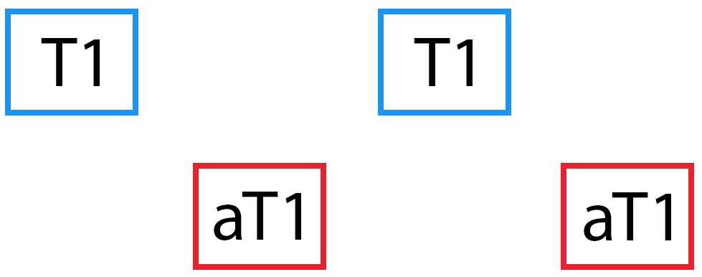
Form: Asynchrony
Form: Asynchrony
Fire & Forget
Non-Blocking
Multiple CPUs

Slide 29

Form: Asynchrony
Where does coffee
come from?
Goal: Develop App
Question

Slide 30
Form: Asynchrony
T1
Coffee, Code, Coffee, Code, Coffee, Code...
aT1
Brewing, Brewing, Brewing, Brewing...

Slide 31
Agenda
Single Threading
Single Threading
Single Threading
Single Threading
Multi Threading
Multi Threading
Multi Threading
Multi Threading
Concurrency in Java
Concurrency in Java
Concurrency in Java
Workflows
Workflows

Slide 32
First...
There were Runnable & Thread

Slide 33
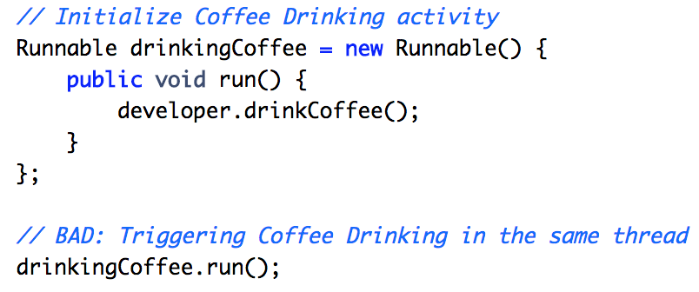
Runnable
Runnable
No Input
No Output
No Exception

Slide 34
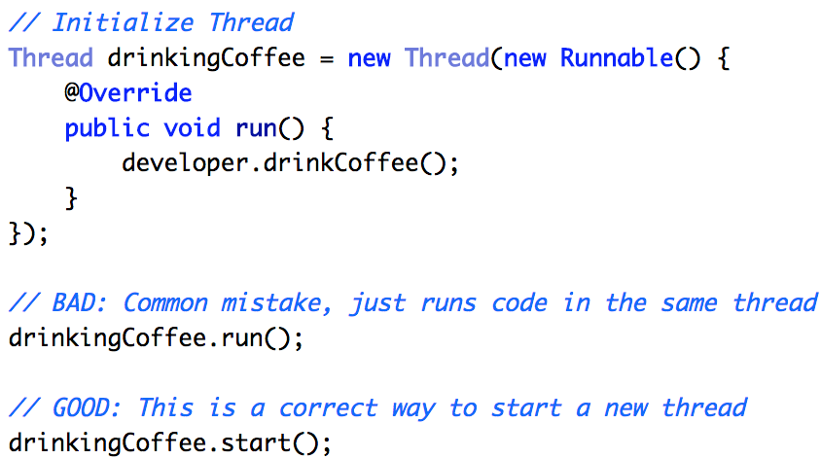
Thread
Thread
Runnable Based
Min. 1 Main Thread
Creation Overhead

Slide 35
Welcome Concurrency API
Then JDK5 was released
Notes:
September 2004

Slide 36
Concurrency API
ThreadLocal
ThreadLocal
Atomic Operations
Atomic Operations
Thread Safe Collections
And More
Thread Safe Collections
Thread Safe Collections

Slide 37
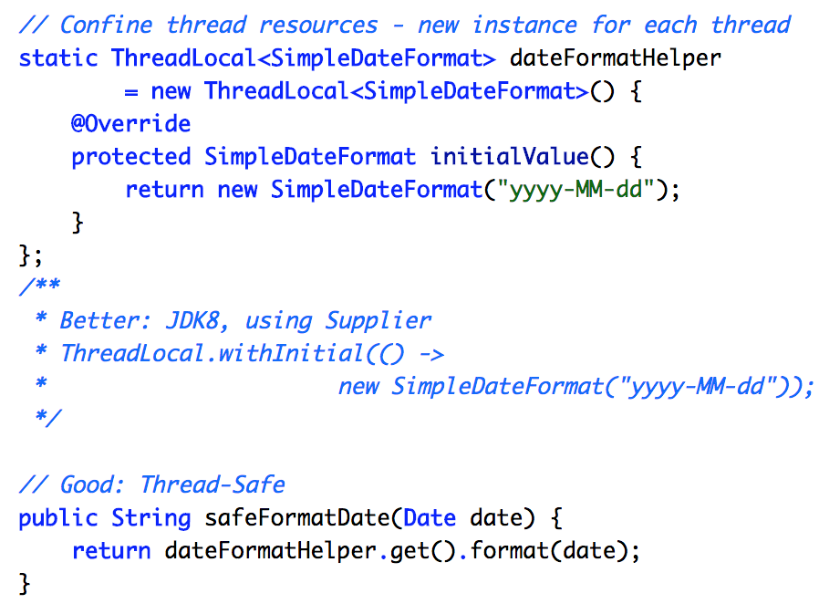
ThreadLocal
ThreadLocal
Resource Confinement
Memory Leaks
Global Fields

Slide 38
Concurrency API
ThreadLocal
ThreadLocal
ThreadLocal
Atomic Operations
Atomic Operations
Atomic Operations
Thread Safe Collections
And More
Thread Safe Collections
Thread Safe Collections

Slide 39
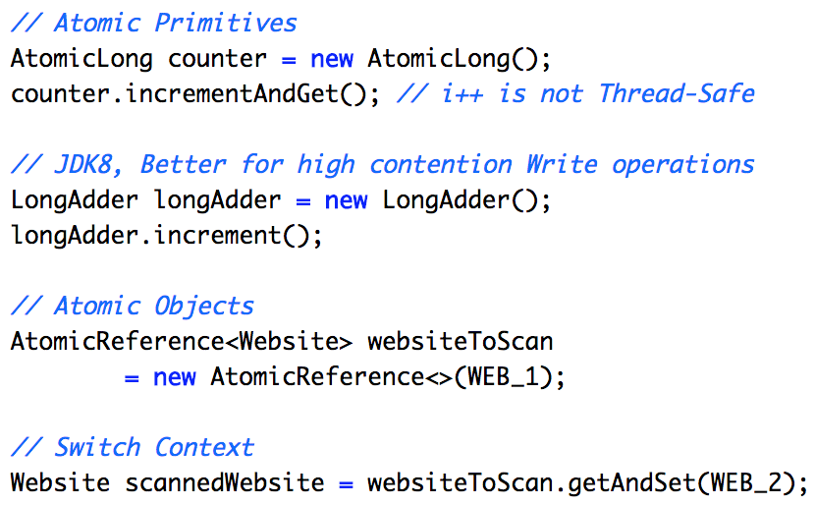
Atomic Operations
Atomic Operations
Compound Operations
↑ Speed
Compare
& Swap

Slide 40
Concurrency API
ThreadLocal
ThreadLocal
ThreadLocal
Atomic Operations
Atomic Operations
Atomic Operations
Atomic Operations
Thread Safe Collections
And More
Thread Safe Collections
Thread Safe Collections
Thread Safe Collections

Slide 41
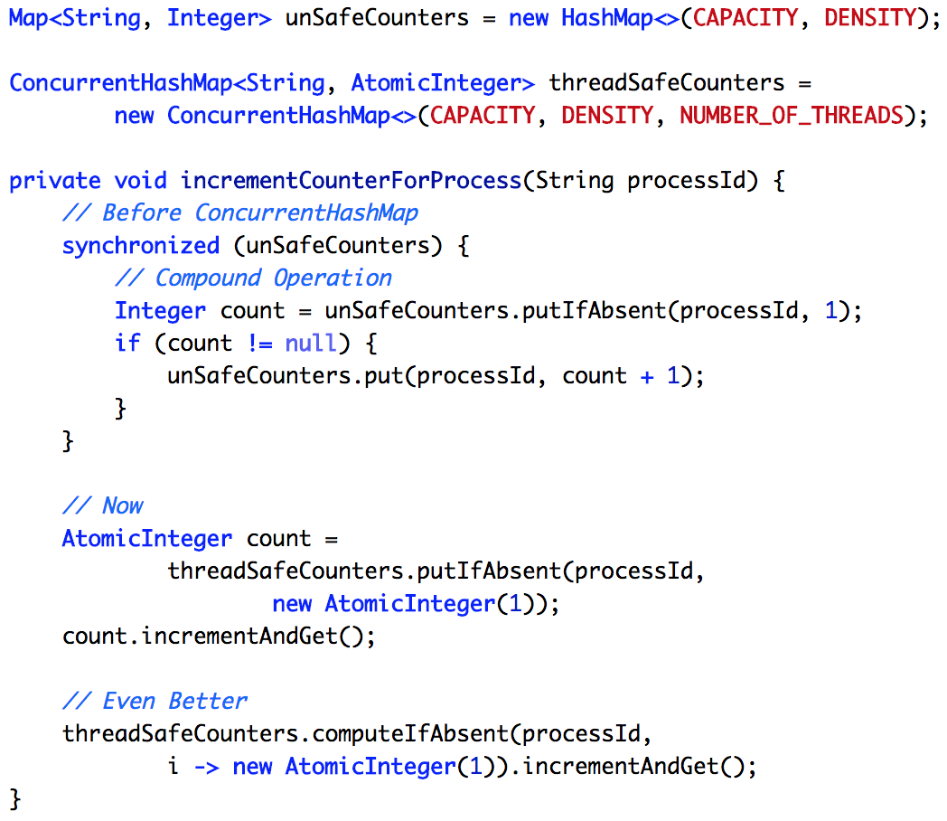
Thread Safe Collections
Thread Safe Collections
ConcurrentHashMap
Compound Operations
↑ Speed
Configurable Concurrency

Slide 42
Agenda
Single Threading
Single Threading
Single Threading
Single Threading
Multi Threading
Multi Threading
Multi Threading
Multi Threading
Concurrency in Java
Concurrency in Java
Concurrency in Java
Concurrency in Java
Workflows
Workflows
Workflows

Slide 43
Where do we start?
Workflows
Promises in JavaScript
Promises in JavaScript
Future/
Callable
Future/
Callable
Executor Framework
Executor Framework
CompletableFuture
CompletableFuture

Slide 44
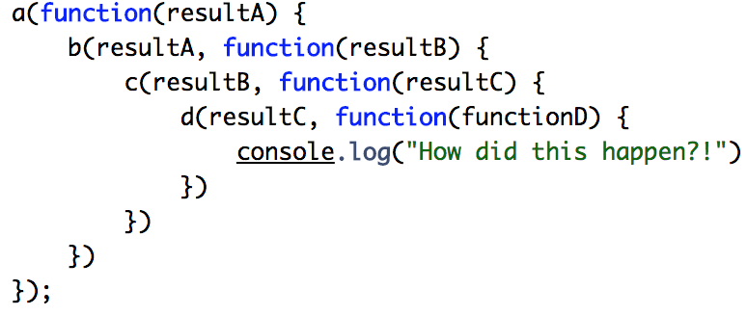
Callback Hell in JavaScript
Callback Hell in JavaScript
Verbose
Intuitive

Slide 45
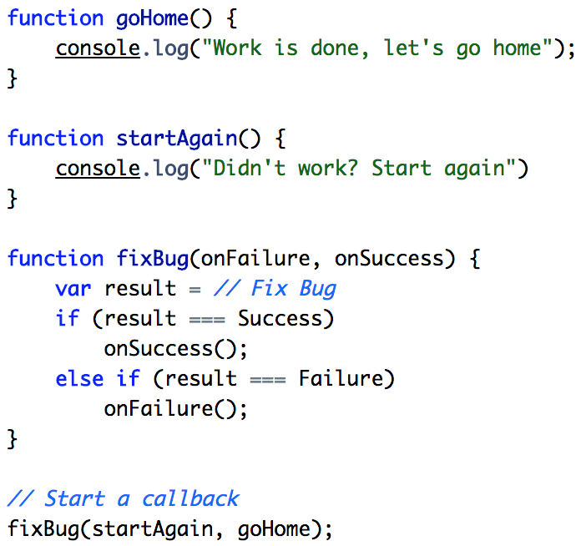
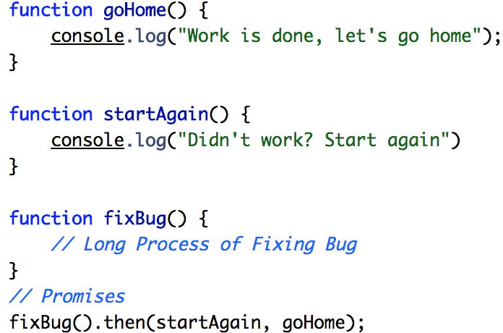
Promises in JavaScript
How do we fix this?
Promises in JavaScript
Before
After

Slide 46
Workflows
Promises in JavaScript
Promises in JavaScript
Promises in JavaScript
Future/
Callable
Future/
Callable
Future/
Callable
Executor Framework
Executor Framework
CompletableFuture
CompletableFuture

Slide 47
Runnable -> Thread
Callable -> Future

Slide 48
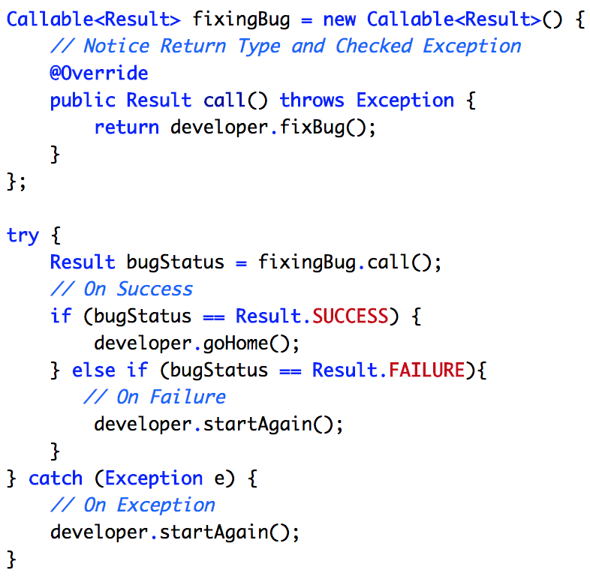
Callable
Callable
No Input
Has Output
Has Exception

Slide 49
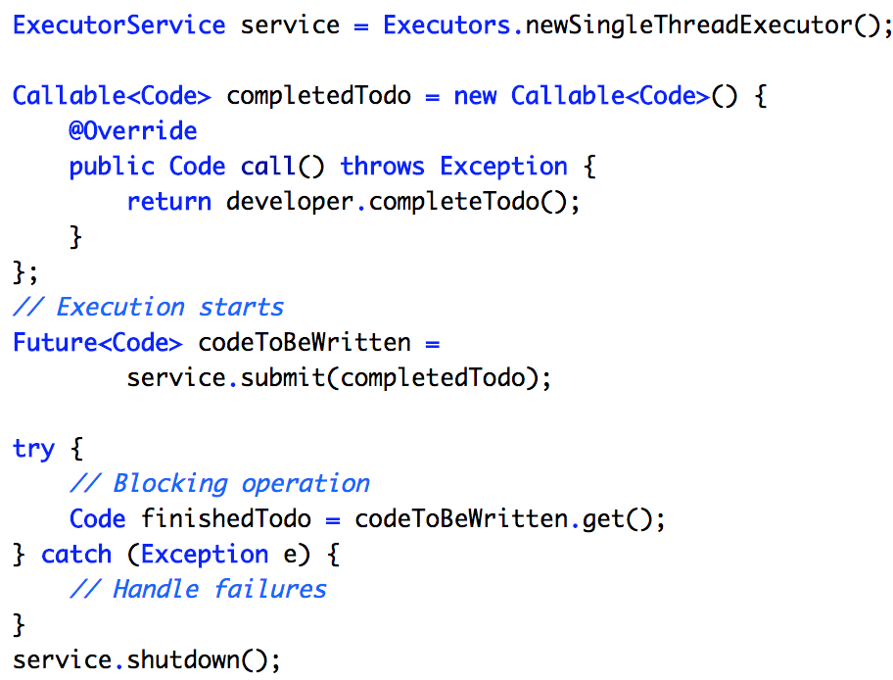
Future
Completed in the Future
Future
Executor Framework

Slide 50
Future sounds great!
But how do we use it?

Slide 51
Workflows
Promises in JavaScript
Promises in JavaScript
Promises in JavaScript
Future/
Callable
Future/
Callable
Future/
Callable
Future/
Callable
Executor Framework
Executor Framework
Executor Framework
CompletableFuture
CompletableFuture

Slide 52
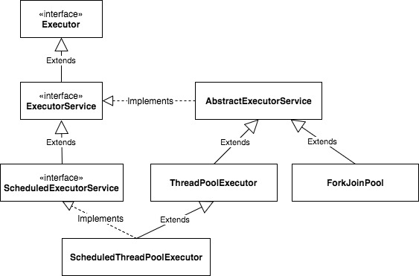
Executor Framework
Executor Framework
Thread Management
Declarative Model

Slide 53
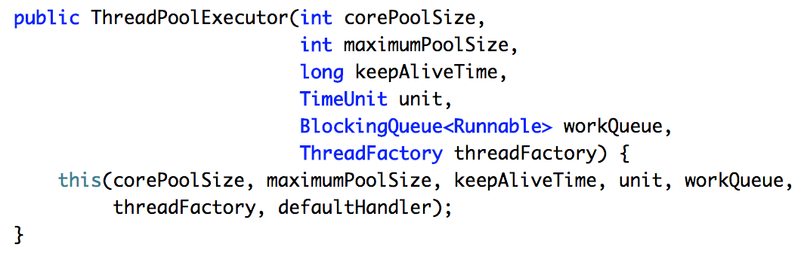
Thread Pool
Thread Pool
Thread Management
Thread Configuration

Slide 54
Too many arguments...
Factories to the rescue!

Slide 55
Executor Factories
Executor Factories
Single Thread Pool
Cached
Thread Pool
Fixed
Thread Pool
Scheduled
Thread Pool
Work Stealing
Pool

Slide 56
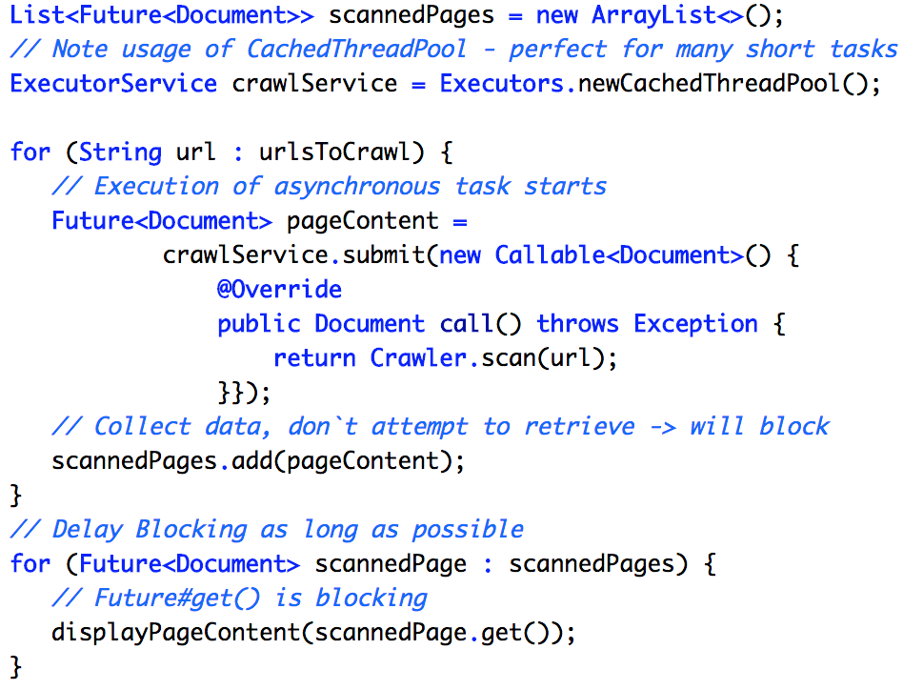
ExecutorService
Executor + Thread Pools
ExecutorService
Async Tasks
Thread Pools

Slide 57
Aren’t we done?
Not really...

Slide 58
Future is not perfect!
Blocking Operations
No Result Chaining
Future Pitfalls
Future Combination
Exception Handling

Slide 59
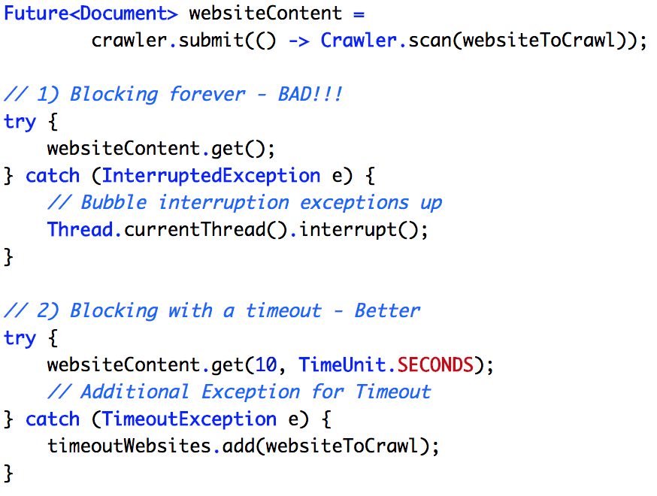
Blocking Result Retrieval
Blocking Result Retrieval
Blocking Get()
Use Timeout

Slide 60
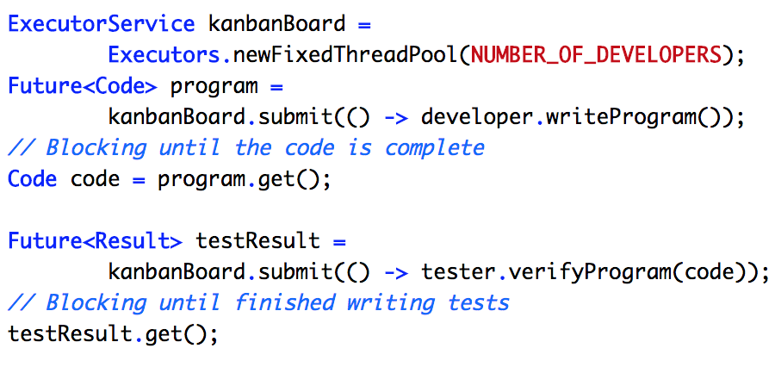
No Futures Chaining
No Futures Chaining
No Workflows
Callback Hell

Slide 61
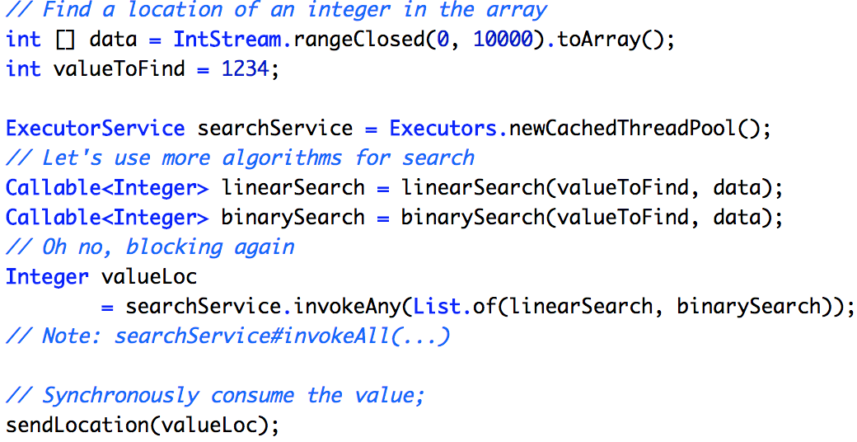
Futures Combination
Futures Combination
Blocking InvokeAny()
Blocking InvokeAll()

Slide 62
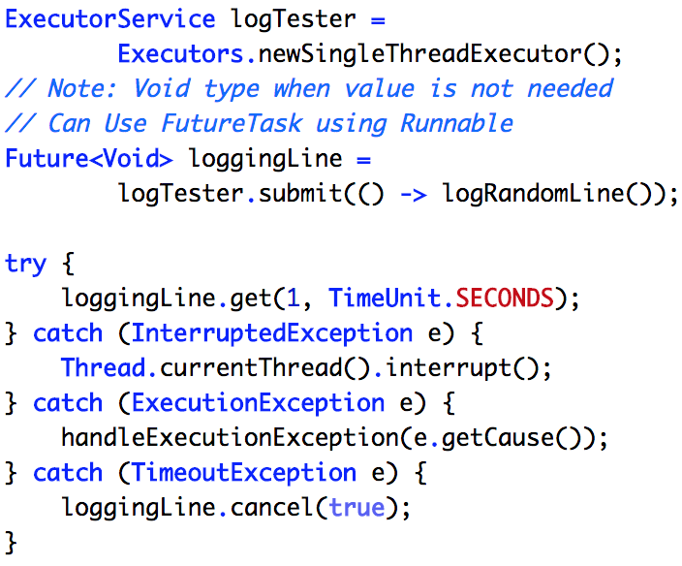
Exception Handling
Exception Handling
Multiple Exceptions
On Most Operations

Slide 63
No worries!
So many issues...
CompletableFuture
is here to help

Slide 64
Workflows
Promises in JavaScript
Promises in JavaScript
Promises in JavaScript
Future/
Callable
Future/
Callable
Future/
Callable
Future/
Callable
Executor Framework
Executor Framework
Executor Framework
Executor Framework
CompletableFuture
CompletableFuture
CompletableFuture

Slide 65
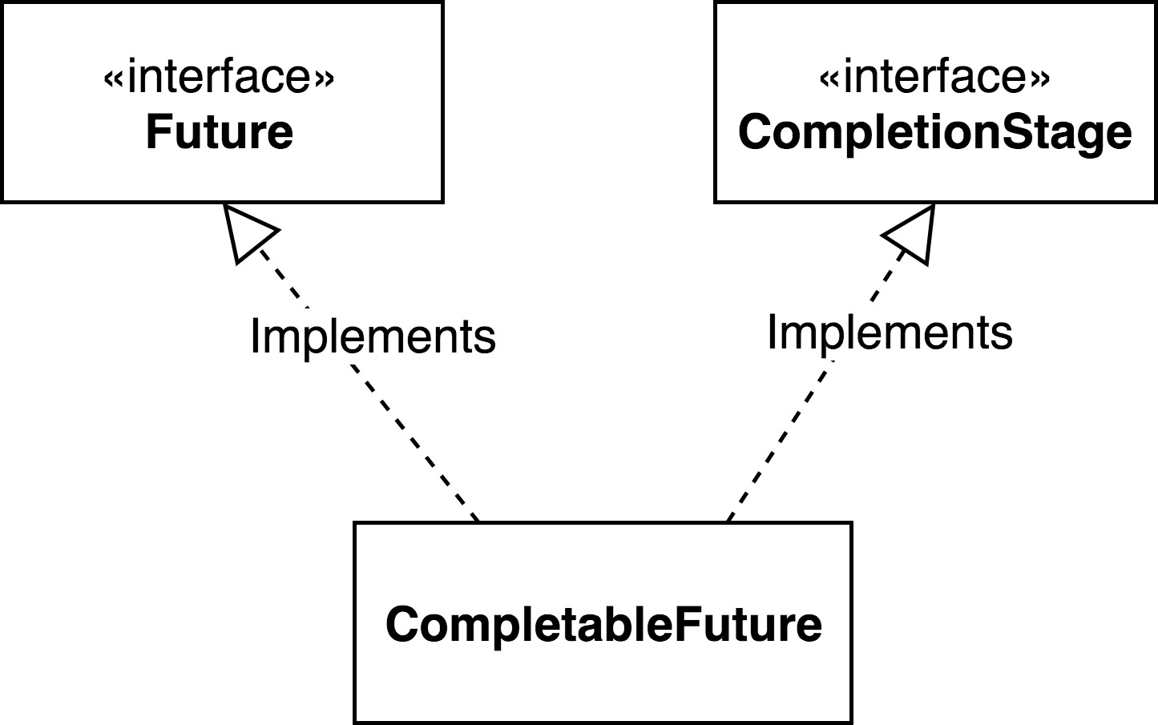
CompletableFuture
CompletableFuture
Transformation
Composition
Chaining
Combination

Slide 66
Future Pitfalls
Blocking Operations
No Result Chaining
No Future Combination
Exception Handling

Slide 67
Let’s handle them with CompletableFuture!

Slide 68
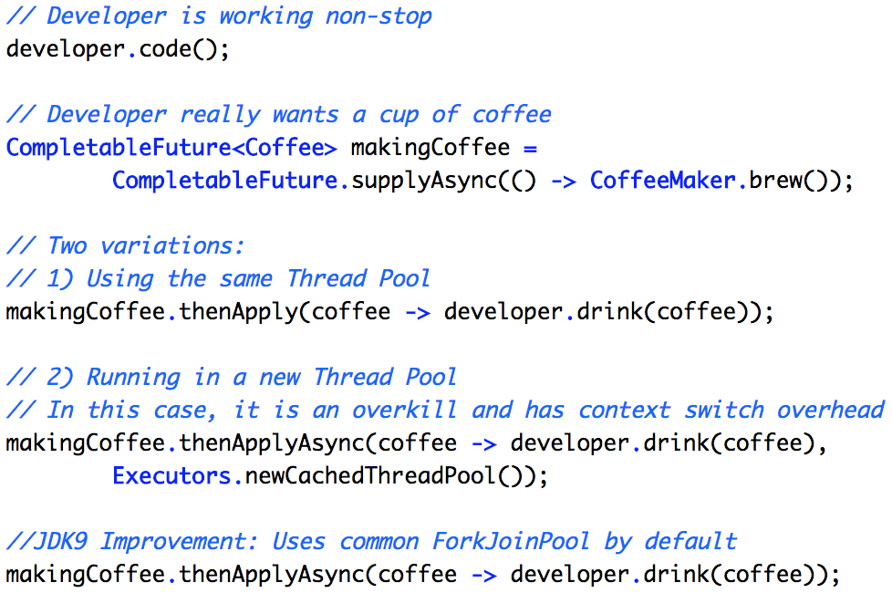
Transformation/Chaining
Transformation/Chaining
Workflows
ForkJoin
Pool

Slide 69
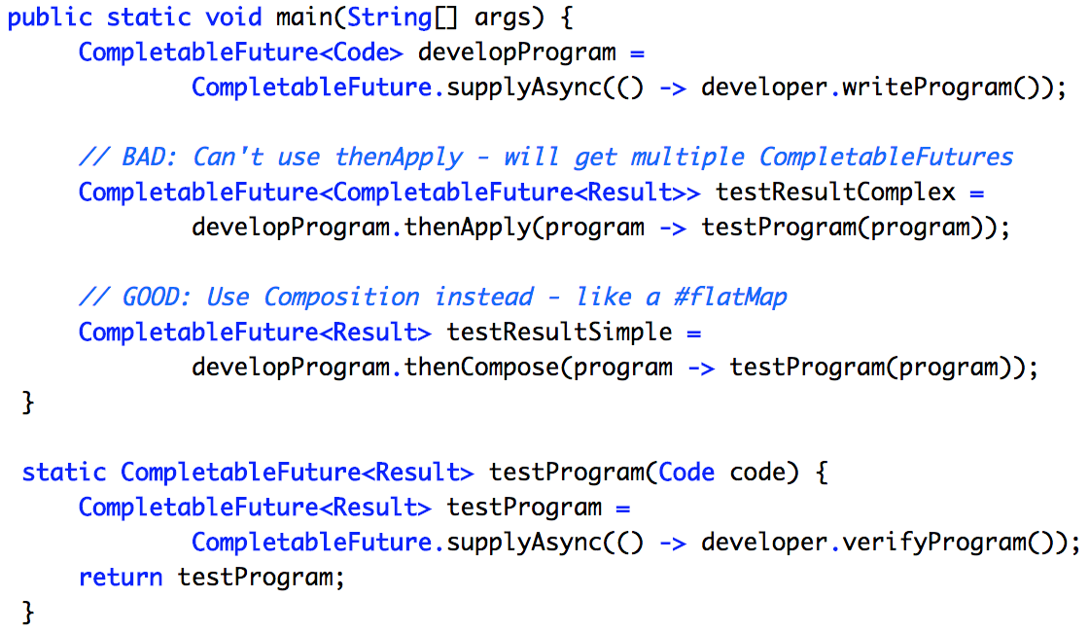
Tasks Composition
Tasks Composition
Workflows
Flat Map

Slide 70
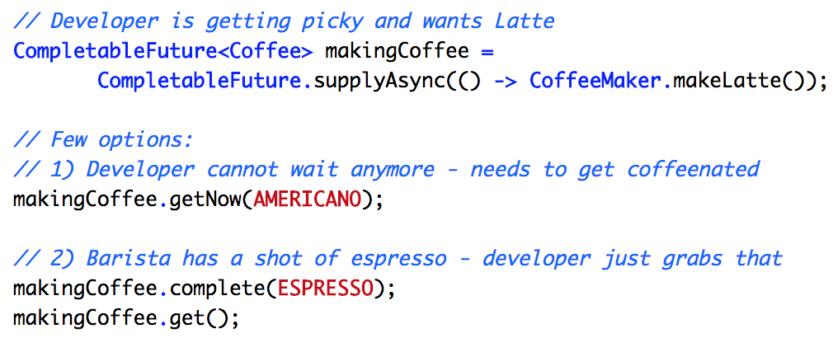
Controllable Futures
Controllable Futures
Completable
Timeout/
Default Value

Slide 71
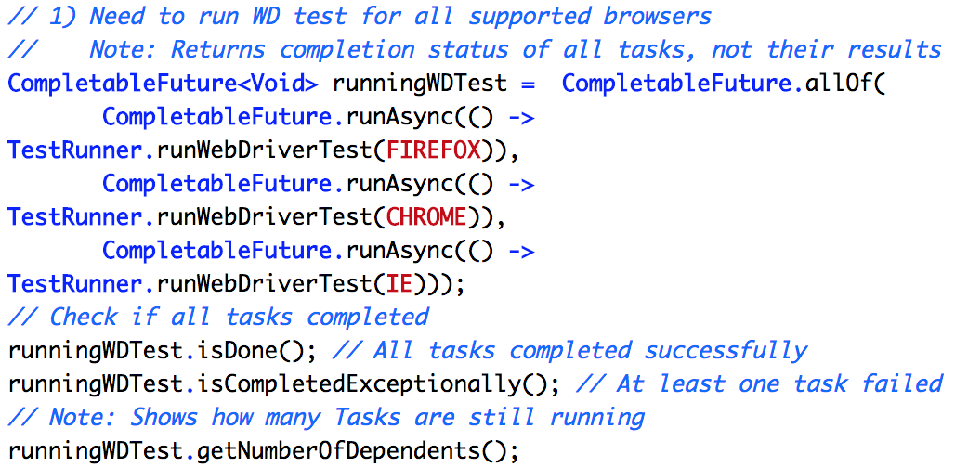
Multiple Futures Control
Multiple Futures Control
AllOf/AnyOf
Results Not Formatted

Slide 72
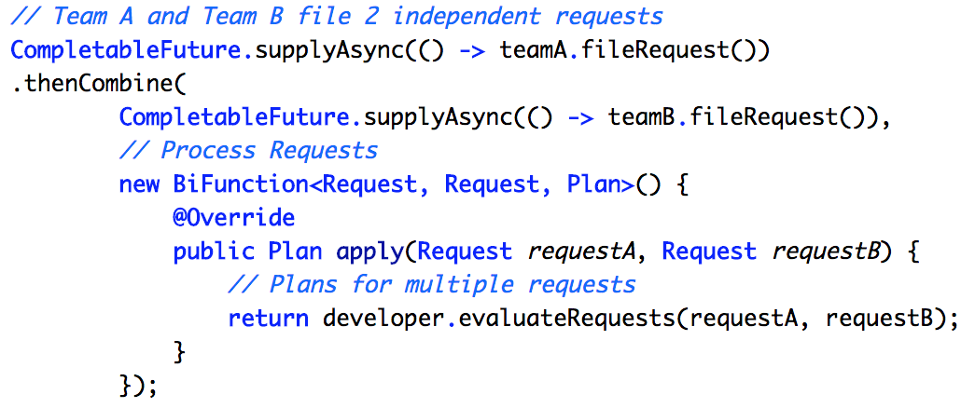
Tasks Combination
Tasks Combination
Collect Results
Sync/Async

Slide 73
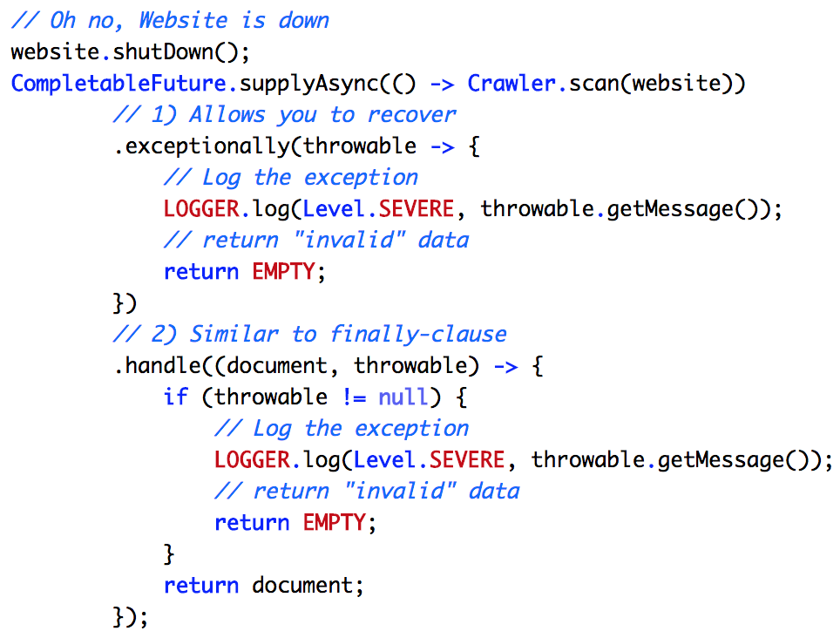
Exception Handling
Exception Handling

Slide 74
Call For Action
Embrace Concurrency
Review Your Application
Continue Learning

Slide 75
Q/A

Slide 76
Contact Speaker
Twitter: @DmitryVinnik
LinkedIn: in/dmitry-vinnik/
Email: dmitry@dvinnik.com

